Slide 1
Issues in Knowledge Representation

Slide 2
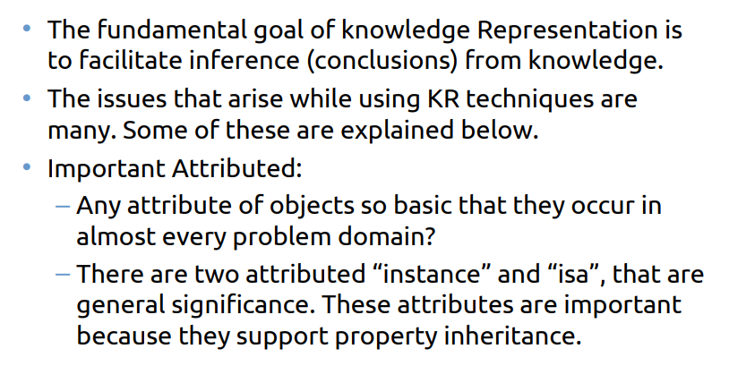
Issues in Knowledge Representation

Slide 3
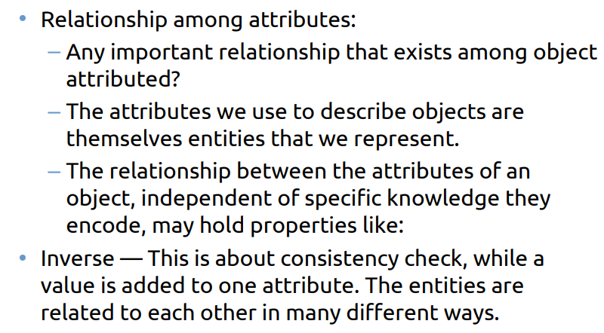
Issues in Knowledge Representation

Slide 4
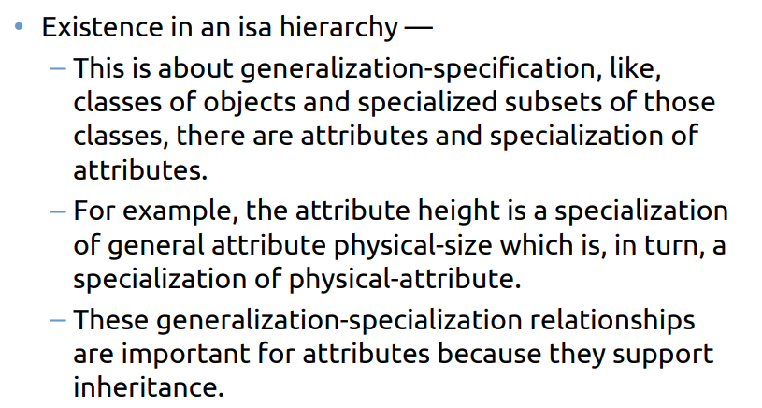
Issues in Knowledge Representation

Slide 5
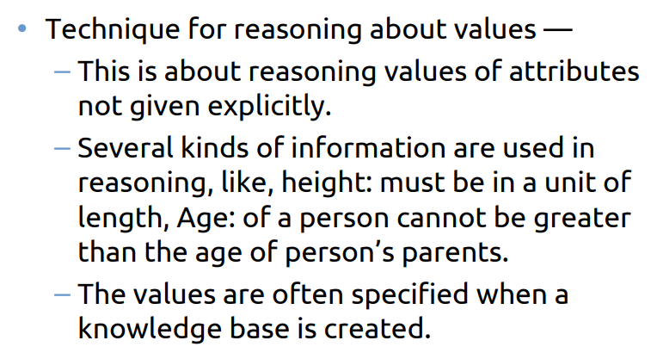
Issues in Knowledge Representation

Slide 6
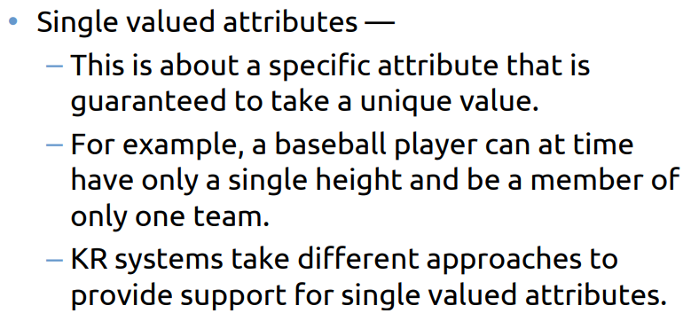
Issues in Knowledge Representation

Slide 7
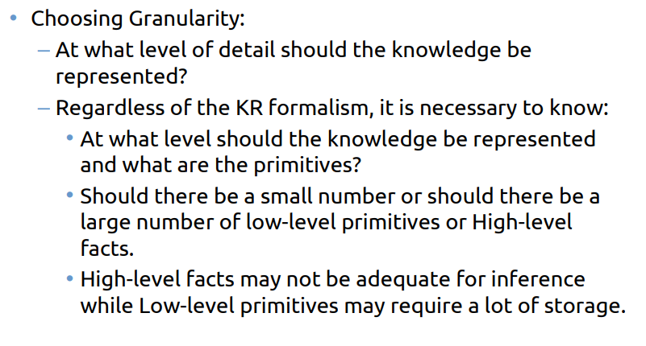
Issues in Knowledge Representation

Slide 8
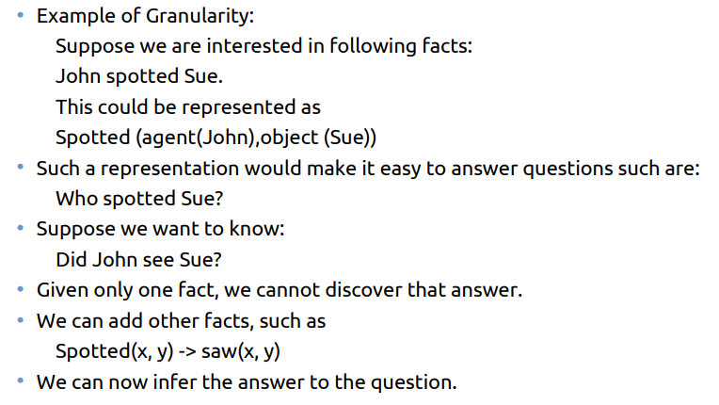
Issues in Knowledge Representation

Slide 9
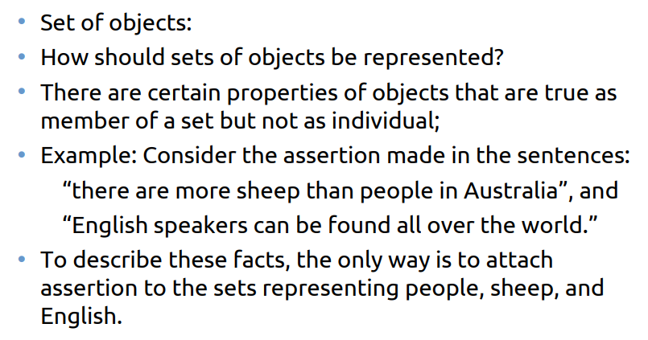
Issues in Knowledge Representation

Slide 10
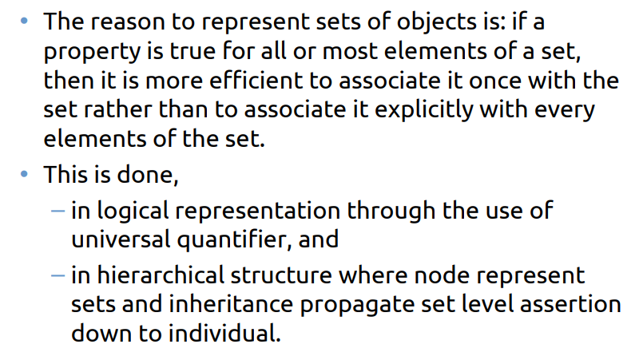
Issues in Knowledge Representation

Slide 11
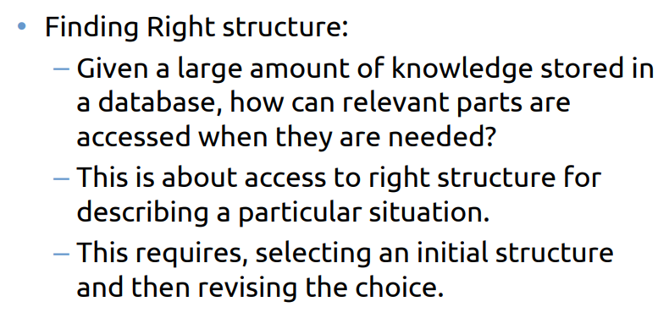
Issues in Knowledge Representation

Slide 12
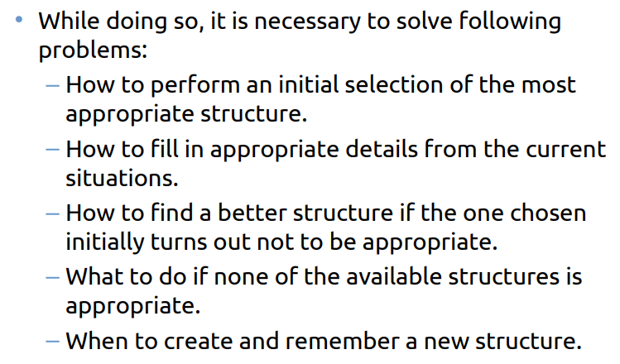
Issues in Knowledge Representation

Slide 13


